Slide 1
Using the Columbia State Website to Guide a First Time College Student through the Admissions Process
Welcome Pretest Objectives Posttest Recap
Enrollment Services Training
Travis Krouse

Slide 2
Introduction
Welcome to this training! We are so happy to have you here.

Slide 3
Please click here to take the Pretest

Slide 4
You are the entry point for so many people embarking on an educational journey that will change their lives forever; this initial transaction has the potential to direct someone into a more prosperous future.
Image Source: http://thumbs.dreamstime.com/t/light-open-door-dark-room-37203057.jpg

Slide 5
The ability to skillfully and successfully guide a new student through the admissions process will result in a smooth, satisfying experience for the student and will give them the tools they need to embark on this journey.
It will also prevent multiple phone calls/visits from students who are frustrated that they were unaware of important information that they needed but were not provided when they first called/visited.

Slide 6
At Columbia State Community College, we believe in our employees. We know that you are intelligent, talented, and caring, and that you have what it takes to create a satisfying student experience from day one.

Slide 7
Successfully leading someone through the admissions process will lead to increased confidence and self-esteem in knowing that you have the ability to set students on the right path.

Slide 8
Upon completing this training, you should be able to use the Columbia State website to guide a prospective first time college student through each step of the admissions process from start to finish.

Slide 9
The main skill (which you should already have) of navigating the Internet with a web browser will be one of your most valuable skills as you use the college’s website to guide the student. Everything that you need to do this job is at your fingertips.
Image Source: http://oandg.co.uk/sites/default/files/web-browsers-.jpg

Slide 10
You should be able to complete this training in an hour or less. It is organized according to the steps in the admissions process, with explanations and illustrations for each step.

Slide 11
To go forward in the training, simply press the arrow button pointing to your right.
To go back in the training, simply press the arrow button pointing to your left.

Slide 12
Objective One: Show the student where to apply on the website

Slide 13
The admissions application for Columbia State Community College is only online; there is no paper application that a student can fill out and turn in. Of course, in order to show a student how to apply to Columbia State on the college website, you have to know how to get to the website. The URL is www.columbiastate.edu. It would be good to make sure that the student understands that the website is not columbiastate.com or anything else, in case they want to spend some time on the website at home.

Slide 14
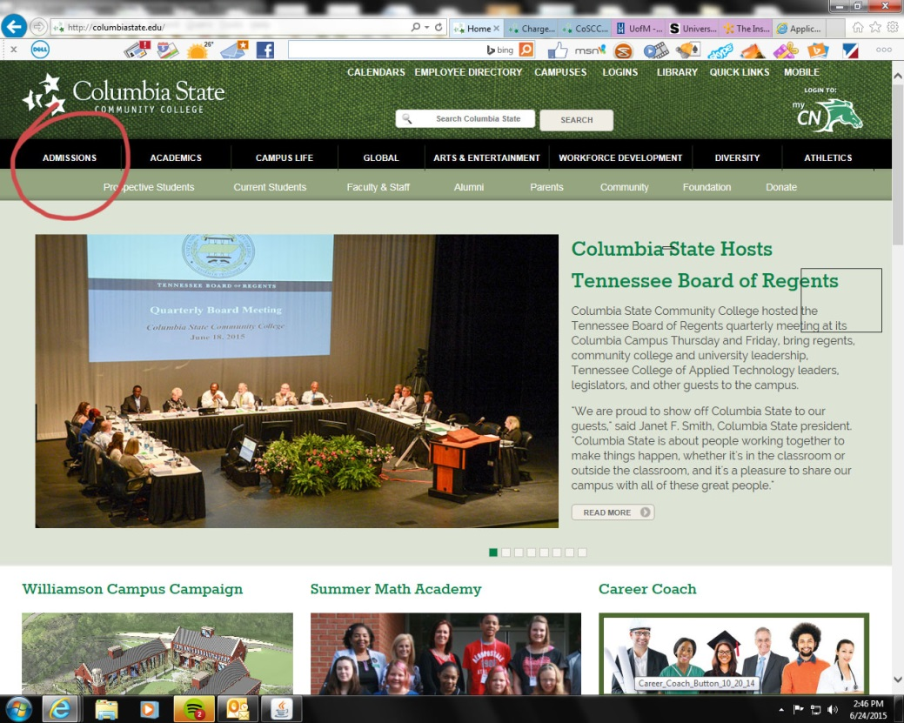
Once you are looking at the homepage, you will see several tabs and links on the page. There are multiple ways that you can navigate to the admissions page on the website, but the easiest way to get there is to just click on the “Admissions” tab in the upper left hand corner of the homepage. This will take you to the Admissions webpage.

Slide 15
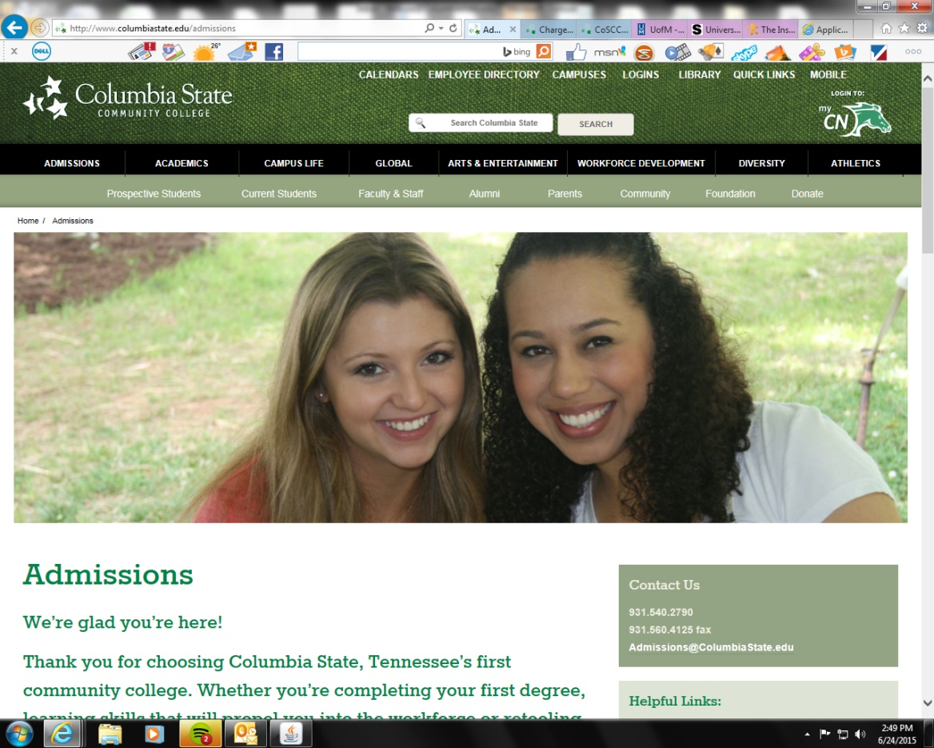

Slide 16
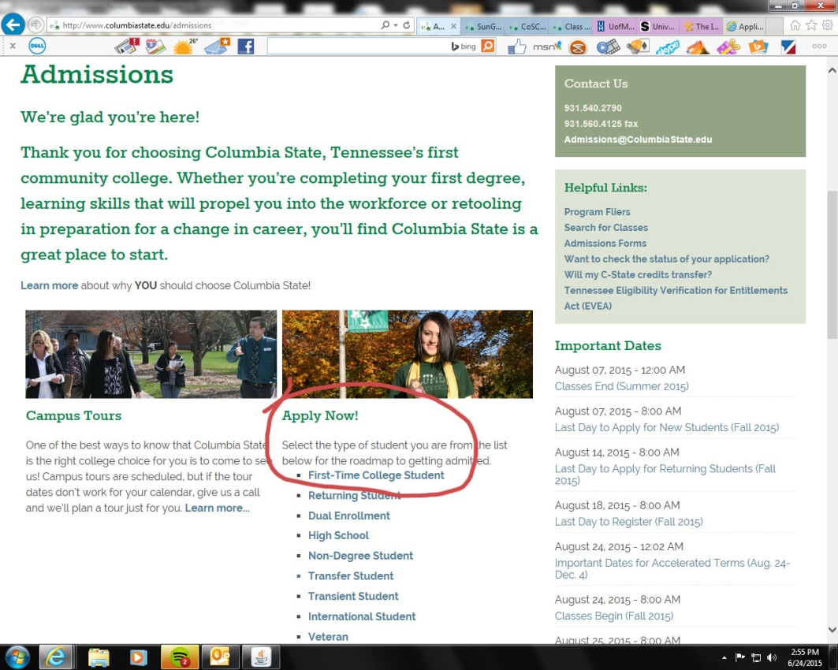
Once you are there, you will see a place in the center of the page where it says, “Apply Now.” Below this, you will click on the link that says, “First Time College Student.”

Slide 17
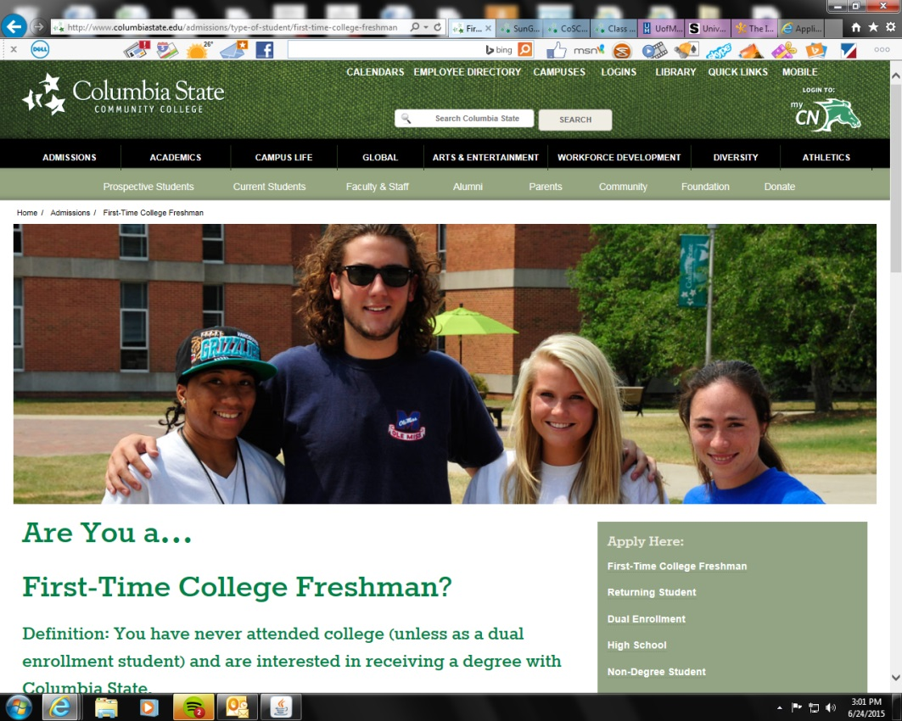
This will take you to a page that gives you step-by-step instructions for a first time college student to apply and get accepted to the college, as well as all of the steps that need to be completed to allow the student to register for classes.

Slide 18
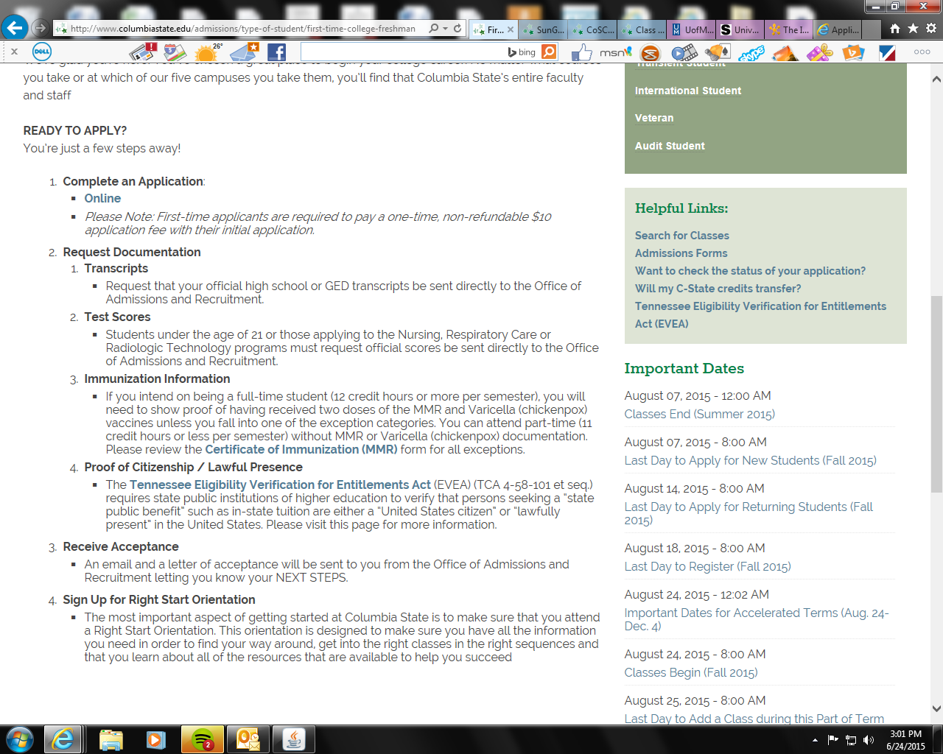
This page will prove to be a valuable aid to you, especially the first few times you guide a student through this process. The first step for the student to complete on this page will be for them to click on the link to the online application, fill out the *application, and submit it.
*Note: There is a one time $10 application fee required for all new applicants.

Slide 19
Learner Participation:
I am a prospective student who comes into your office and asks you, “Can you please give me an application to the college?” How are you going to answer me?

Slide 20
Test Item- Which is the correct URL for the Columbia State website?
a. www.c-state.edu
b. www.columbiastate.edu
c. www.columbiastate.com
d. www.cscc.edu

Slide 21
Correct!
The correct URL is www.columbiastate.edu!

Slide 22
Test Item- Where is the Admissions tab on the Columbia State website?
a. Under the "About Us" section at the bottom.
b. On the Admissions page.
c. In the upper left hand corner of the home page.
d. On the financial aid page.

Slide 23
Correct!
It is in the upper left hand corner of the home page!

Slide 24
Objective Two:
Go over transcript requirements

Slide 25
All first time freshmen are required to *provide either official high school transcripts or official GED scores to the admissions office in order to be admitted to the college.
If a student either has not or will not graduate from high school, then they must be able to provide GED scores to the admissions office. A GED is considered equivalent to high school and will allow a student to start college just as well as a high school transcript.
*Note: Columbia State does not request transcripts on the student’s behalf; it is the responsibility of the student.

Slide 26
There are specific requirements for what makes a transcript “official.” If the student requests the high school or GED testing center to send the transcript directly to the Columbia State admissions office, they may send it any way they choose (i.e. mail, fax, email, or some other electronic delivery method) and the transcript will be considered official.

Slide 27
If the student hand delivers the high school or GED transcript to the admissions office, then the transcript must be placed in a sealed envelope by the high school or testing center and it must be turned in to the admissions office unopened.
Otherwise, the transcript will not be considered official, and the admissions office will not be able to use it to admit the student to the college.

Slide 28
Learner Participation:
I am a prospective student who is interested in applying to Columbia State. You tell me that the admissions office requires my official high school transcript or GED transcript in order to be admitted. I reach into my pocket and pull out a folded piece of paper that has my name on it and says “high school transcript” at the top. I hand you the paper and say, “I already have my transcript right here.” What do you say to me?

Slide 29
Test Item- True/False If a student has a GED, then a high school transcript is not required.
True
False

Slide 30
Correct!
If a student has a GED, that takes the place of a high school transcript!

Slide 31
Test Item- True/False Columbia State will accept unofficial transcripts for admissions purposes.
True
False

Slide 32
Correct!
Columbia State only accepts official transcripts.

Slide 33
Test Item- Which of the following terms fall under the category of Transcripts?
a. ACT, SAT, and Compass
b. high school and GED
c. MMR and Varicella

Slide 34
Correct!

Slide 35
Objective Three:
Go over placement testing requirements

Slide 36
All first time college students are required to have taken a placement exam before it can be determined what type of classes they will be able to register for.
The three types of placement exams that Columbia State will accept are the ACT, the SAT, and the Compass.
The ACT and SAT are both national exams that many if not most high school students will take at one time or another. If a prospective student has taken one of these exams, they will need to provide those scores to the admissions office.

Slide 37
If the student has not taken an ACT or SAT test, or if the student’s scores are too old (more on this below), then the student will either need to take another ACT or SAT, or the student may take a Compass test.
The Compass is an in-house placement test that a student may take for free in the Columbia State testing center, and it will satisfy the placement requirements just as well as an ACT or SAT.

Slide 38
In order for placement exam scores to be accepted by the office of admissions, they must be less than 3 years old at the time that the student’s first semester will begin.
For instance, if a student is applying to the college in June of 2015 to start school in the fall semester (August), and they took an ACT test in July of 2012, those scores will be too old. Even though they are less than 3 years old now (just barely!) they will be more than 3 years old when the fall semester starts in August.
A first time college student who does not have placement test scores less than 3 years old will need to take another placement test.

Slide 39
Learner participation:
I am a prospective first time college student who last took an ACT test five years ago. You inform me that my scores are too old to be used for placement purposes at Columbia State. I reply, “Does this mean that I gotta take another ACT?” How will you answer me?

Slide 40
Test Item- If it is 2015 and a student took an ACT test in 2010, will the admissions office be able to use his/her scores for placement purposes?
a. Yes
b. No

Slide 41
Correct!

Slide 42
Test Item- Which of the following is not a placement exam accepted by Columbia State?
a. SAT
b. GED
c. ACT
d. Compass

Slide 43
Correct!
The GED is not a placement exam.

Slide 44
Test Item- To be used for placement purposes, placement exam scores must not be older than:
a. 10 years old
b. 3 years old
c. 2 years old
d. 5 years old

Slide 45
Correct!

Slide 46
Test Item- Which of the following terms fall under the category of Placement Exams?
a. ACT, SAT, and Compass
b. high school and GED
c. MMR and Varicella

Slide 47
Correct!

Slide 48
Objective Four:
Go over immunization requirements

Slide 49
The state of Tennessee requires college students to satisfy certain immunization requirements in order to be able to attend college full time (12 credit hours or more).
Students are required to provide proof that they have had two doses of the MMR (measles, mumps, rubella) and two doses of Varicella (chickenpox) vaccines in order to be able to register for a full time schedule.
Image Source: http://www.usd261.com/Images/Pictures/immunizations.jpg

Slide 50
Certain students may fall into an exemption category wherein they wouldn’t be required to provide proof of these immunizations. These exemption categories include religious exemptions and medical exemptions, among others.
Unless a student falls into one of these exemption categories, that student will not be allowed to register for more than 11 credit hours until the required immunization records are provided to the admissions office.

Slide 51
Learner participation:
I am a prospective student whom you have informed of the immunization requirements for full time students. You have looked at all of the exemption categories and I don’t fall into any of them. I tell you, “I can’t get my immunization records. Does that mean I can’t go to school?” How do you answer me?

Slide 52
Test Item- Immunization records are required before a student can:
a. be admitted to the college.
b. receive financial aid.
c. attend Right Start Orientation.
d. register for a full time schedule.

Slide 53
Correct!
Immunization records are required if a student wants to be full time.

Slide 54
Test Item- The immunizations that full time students are required to provide proof of are:
a. 2 doses of Hepatitis B and 2 doses of MMR.
b. 2 doses of MMR and 2 doses of Meningitis.
c. 2 doses of Varicella and 2 doses of MMR.
d. 2 doses of Varicella and 2 doses of Hepatitis B.

Slide 55
Correct!

Slide 56
Test Item- True/False No one is exempt from the immunization requirements.
True
False

Slide 57
Correct!
Someone who falls into an exemption category may be exempt from immunization requirements.

Slide 58
Test Item- Which of the following terms fall under the category of Immunizations?
a. ACT, SAT, and Compass
b. high school and GED
c. MMR and Varicella

Slide 59
Correct!

Slide 60
Objective Five:
Go over citizenship/lawful presence requirements

Slide 61
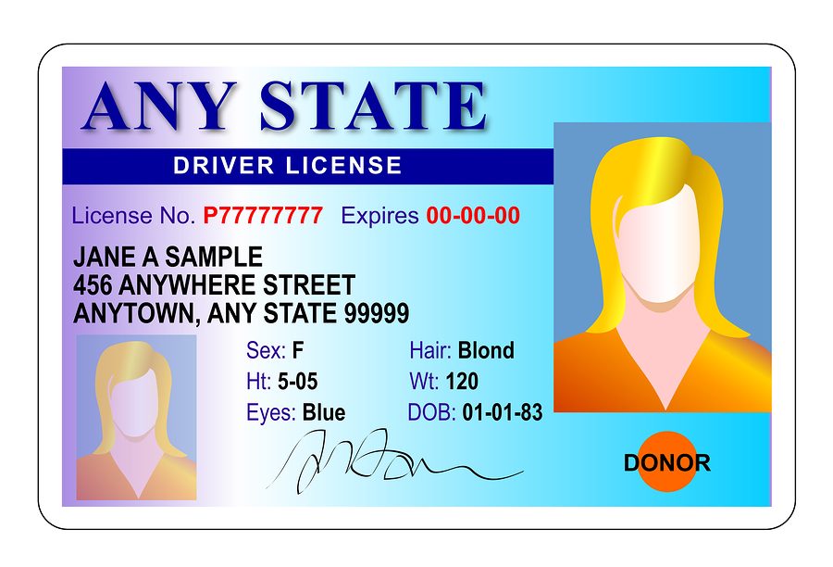
The state of Tennessee requires all students who want to receive an in-state benefit (such as in-state tuition) to provide documentation that proves that they are either a U.S. citizen *or that they are lawfully present in the United States.
If a student is unable to provide this documentation to the admissions office, they will be charged out-of-state tuition (which is more than 3 times the cost of in-state tuition!)
*A student can receive in-state tuition if they are lawfully present in the United States even if they are not a U.S citizen.
Image Source: http://3.bp.blogspot.com/-hoAAfMIQIxk/UNy42H-ye6I/AAAAAAAAFE8/Liq7uWZACk0/s1600/generic+drivers+license+any+state+id+card.jpg

Slide 62
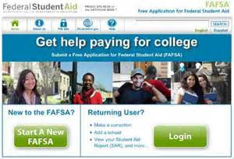
On the application page there is a link to a page that lists acceptable forms of documentation to satisfy this requirement, the most common of which is the Free Application for Federal Student Aid (FAFSA) for financial aid.
Image Source: https://sp.yimg.com/ib/th?id=JN.ohKNizjHWC4m8h3T0zT9DA&pid=15.1&P=0

Slide 63
Learner participation:
I am a prospective first time college student who has informed you that I am not a U.S. citizen but that I have documentation that I am a permanent resident who is lawfully present in the United States. You inform me that I cannot receive in-state tuition. Is this the correct answer? Why or why not?

Slide 64
Test Item- True/False A student must be a U.S. citizen in order to be eligible for the in-state tuition rate.
True
False

Slide 65
Correct!
A student doesn’t have to be a U.S. citizen to receive in-state tuition if they can provide acceptable documentation that they are lawfully present in the United States.

Slide 66
Objective Six:
Inform the student of the requirement to attend Right Start Orientation

Slide 67
The final step in the admissions process is for a first time college student to attend Right Start Orientation. This is a requirement for all first time freshmen, and a student will not be allowed to register for any classes until they attend orientation.
The purpose of orientation is for the student to receive all of the information that they need to be able to start their classes successfully.

Slide 68
At the orientation, each student meets with an advisor who helps them to register for their classes. Therefore, when they walk out of orientation they should have their classes scheduled.

Slide 69
Learner participation:
I am a prospective first time college student who has applied to the college and submitted official transcripts and ACT scores. You inform me that I will now be admitted to the college shortly. I then ask you, “So at that point, will I be able to just go online and register for my classes?” How do you answer me?

Slide 70
Test Item- Select the option that has the steps of the admissions process in the correct order.
a. (1) Attend Right Start Orientation (2) Apply to the college (3) Register for classes (4) Submit official transcripts
b. (1) Register for classes (2) Attend Right Start Orientation (3) Submit official transcripts (4) Apply to the college
c. (1) Apply to the college (2) Submit official transcripts (3) Attend Right Start Orientation (4) Register for classes
d. (1) Submit official transcripts (2) Attend Right Start Orientation (3) Apply to the college (4) Register for classes

Slide 71
Correct!

Slide 72
Please click here to take the
Posttest

Slide 73
We are now going to walk through the steps in the application process one more time by following the prompts on the webpage.
Remember that while it is helpful for you to memorize this information, it is not required. You always have this webpage which acts as a prompt that lays out the steps for you to walk through with the prospective student.

Slide 74
Some of the information we have discussed, such as the expiration date for exam scores, is not explicitly stated on the webpage.
Other pieces of information we have discussed are not directly stated on the webpage, but there are links to the information, such as the immunization exemptions and the acceptable forms of citizenship documentation.
The more that you go through these steps using the website as a prompt, the more familiar you will become with the material and the less you will find yourself relying on it.

Slide 75
Eventually you will be able to do this from memory and you will only need to use the website for the student’s benefit. But initially, you don’t have to let on to them how much you are relying on it! You can leave them with the impression that you knew all of this information from the beginning if you can present it convincingly.

Slide 76
Show the student where to apply on the website
Go over transcript requirements
Go over placement exam requirements
Go over immunization requirements
Go over citizenship requirements
Inform the student of the requirement to attend Right Start Orientation

Slide 77
Congratulations! You have now successfully completed this unit.

Slide 78
Incorrect!
(Please try again!)

